Slide 1
Perspectives on education reform, critical thinking, and assessment
Kristine nugent
Fulbright fellow
May 7, 2019

Slide 2
Welcome!
Who am I?

Slide 3
curriculum: animal planet
Ages 7-11

Slide 4
Our plan
Part 1: Critical thinking
Part 2: Assessment

Slide 5
Part 1: critical thinking

Slide 6
Goals of education reform in ukraine
“Instead of memorizing facts and definitions, students will acquire competencies. This is a dynamic combination of knowledge, skills, ways of thinking, opinions, values, and other personal qualities that determine a person's ability to socialize well and to engage in professional and/or further learning activities. In other words, core knowledge is formed that will be supplemented with the ability to use this knowledge, with values and skills that Ukrainian school leavers will need in their professional and personal life.”
https://mon.gov.ua/eng/tag/nova-ukrainska-shkola

Slide 7
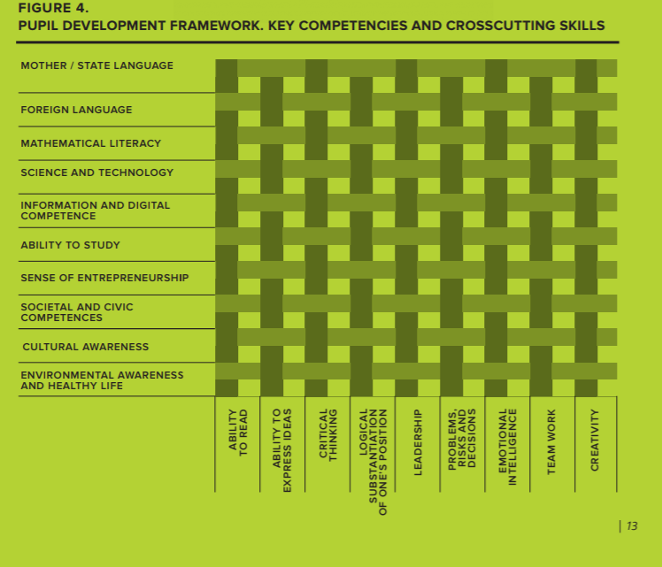
https://mon.gov.ua/storage/app/media/zagalna%20serednya/Book-ENG.pdf

Slide 8
What is critical thinking?
We hear about it everywhere!

Slide 9
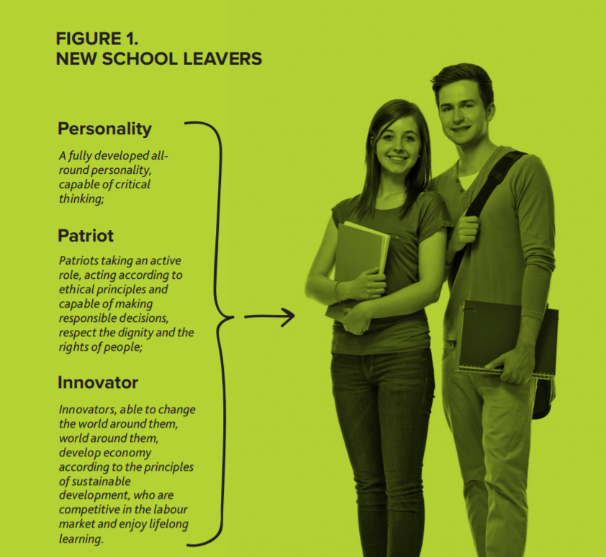
The New Ukrainian School: Conceptual Principles of Secondary School Reform (Ministry of Education and Science of Ukraine)
critical thinking
https://mon.gov.ua/storage/app/media/zagalna%20serednya/Book-ENG.pdf

Slide 10
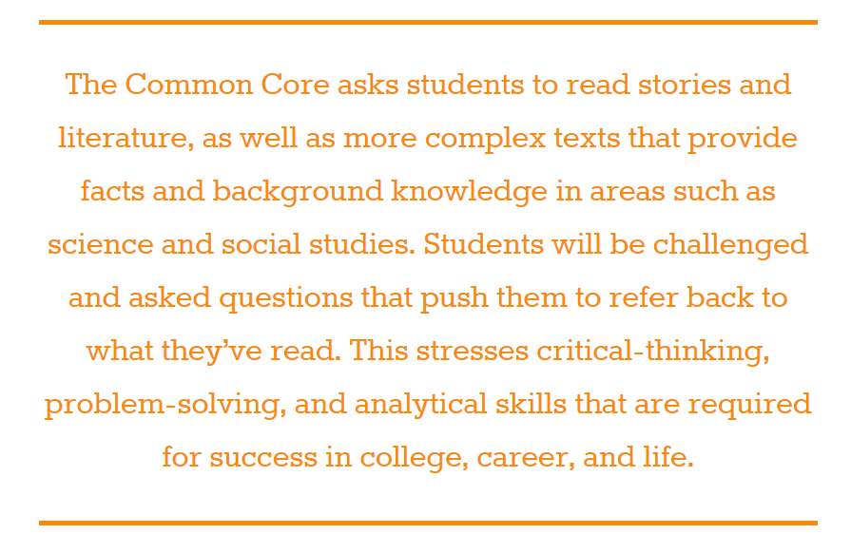
critical thinking
http://www.corestandards.org/ELA-Literacy/

Slide 11
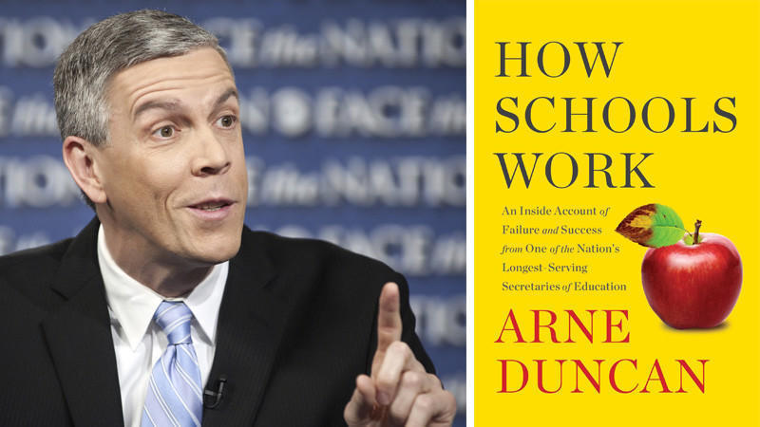
https://www.chicagotribune.com/lifestyles/books/ct-books-how-schools-work-arne-duncan-0805-story.html

Slide 12
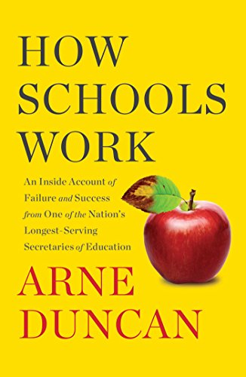
“Our schools were beautifully designed to meet exactly their intended purpose, which was to prepare the bulk of kids for assembly-line work in factories, while also picking a small number of kids to be the elite that managed those factory workers. This is a completely outmoded way of thinking about education. At the highest level we need to change the way we think about what schools prepare kids to do and how we go about doing that…
We don’t need rote knowledge anymore: we have the Internet and Wikipedia for that. What we need are kids who can learn anything and continue to be able to learn anything for the rest of their lives. We need kids who can think, not just recall. ”
Arne Duncan, How Schools Work

Slide 13
“Our schools were beautifully designed to meet exactly their intended purpose, which was to prepare the bulk of kids for assembly-line work in factories, while also picking a small number of kids to be the elite that managed those factory workers. This is a completely outmoded way of thinking about education. At the highest level we need to change the way we think about what schools prepare kids to do and how we go about doing that…
We don’t need rote knowledge anymore: we have the Internet and Wikipedia for that. What we need are kids who can learn anything and continue to be able to learn anything for the rest of their lives. We need kids who can think, not just recall. ”
Arne Duncan, How Schools Work

Slide 14
Critical thinking definition
“Critical thinking is a term used by educators to describe forms of learning, thought, and analysis that go beyond the memorization and recall of information and facts…
In its most basic expression, critical thinking occurs when students are analyzing, evaluating, interpreting, or synthesizing information and applying creative thought to form an argument, solve a problem, or reach a conclusion.”
https://www.edglossary.org/critical-thinking/
https://www.thoughtco.com/what-is-critical-thinking-p2-249753

Slide 15
Creative thinking definition
“Creative thinking involves students learning to generate and apply new ideas in specific contexts, seeing existing situations in a new way, identifying alternative explanations, and seeing or making new links that generate a positive outcome.”
https://medium.com/constraint-drives-creativity/10-creativity-challenges-to-exercise-your-creative-confidence-ff6f19ba4241
https://www.australiancurriculum.edu.au/f-10-curriculum/general-capabilities/critical-and-creative-thinking/

Slide 16
When critical thinking takes place, the results can look smooth and inevitable.
Sometimes the absence of critical thinking is what can best illuminate what critical thinking actually is.

Slide 17
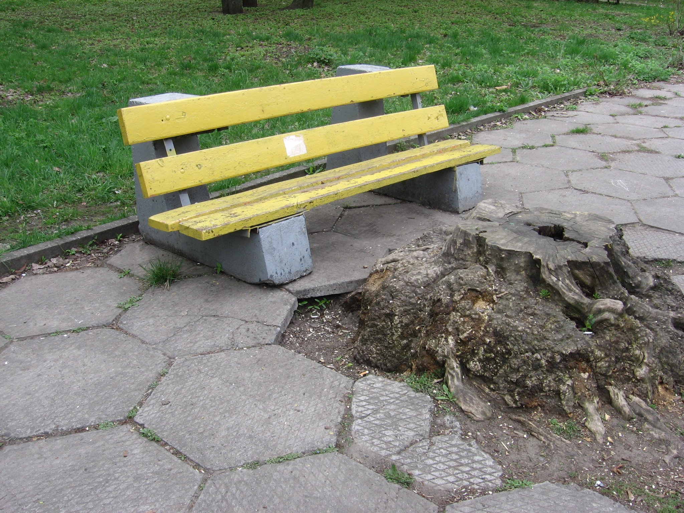
“Critical thinking occurs when students are analyzing, evaluating, interpreting, or synthesizing information and applying creative thought to form an argument, solve a problem, or reach a conclusion.” https://www.edglossary.org/critical-thinking/
How did this happen?
A breakdown in critical thinking….
What can be done instead?
An exercise in creative thinking….

Slide 18
What does the absence of critical thinking look like in the classroom?
Teacher: Why?
Student: That wasn’t in the reading.

Slide 19
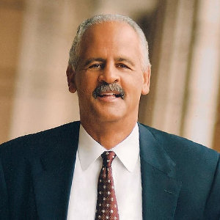
Why does critical thinking matter?
It’s not about the gadgets. Most of us have access to technology. In fact, the more we are investing in the latest and greatest technology, the less we tend to invest in the greatest gadget of all: our minds.
We need to hear the phrase “I wonder...” more often and see the lowered eyelids of people staring at a screen for information less.
We need to go back to the basics. We need to think.
The more we saturate our landscape with technology, the less we need to think.
Answers can be too easy to find.
We need to reignite will, wonder and wisdom. And we need to do it now.
Stedman Graham
https://www.huffingtonpost.com/stedman-graham/thinking-matters-critical_b_6317198.html

Slide 20
Why is critical thinking important in the foreign language classroom?

Slide 21
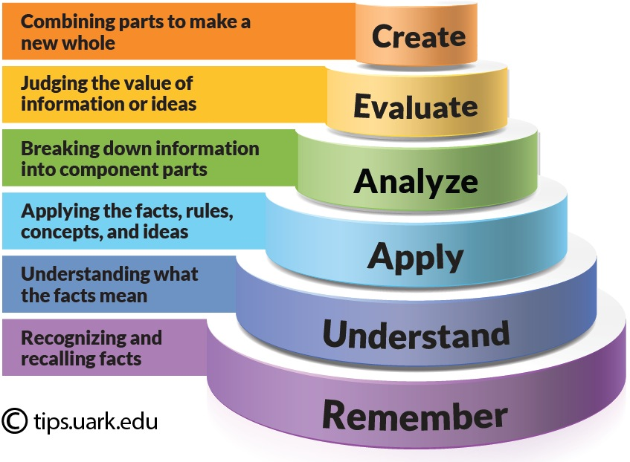
Bloom’s taxonomy
Foreign language teaching
Is there something wrong with this?
Not necessarily!

Slide 22
The true goal of foreign language learning…
creating meaning using previously incomprehensible sounds

Slide 23
Foreign language learning is actually the perfect avenue for developing critical thinking:
Language is inherently creative, and creating engages all levels of thought processes
As language teachers, we have lots of flexibility over which subjects/topics/themes we use to support foreign language learning and can choose to make critical thinking central

Slide 24
Foreign language teaching

Slide 25
what about low proficiency levels?
https://learningjourneypidp3100.wordpress.com/2016/02/21/deer-in-headlights/

Slide 26
Arguments for critical thinking in the foreign language classroom, regardless of student level:
Critical thinking is skill that needs to be developed across disciplines; it should not be compartmentalized. Critical thinking processes that are carried out in the L1 are still valid!

Slide 27
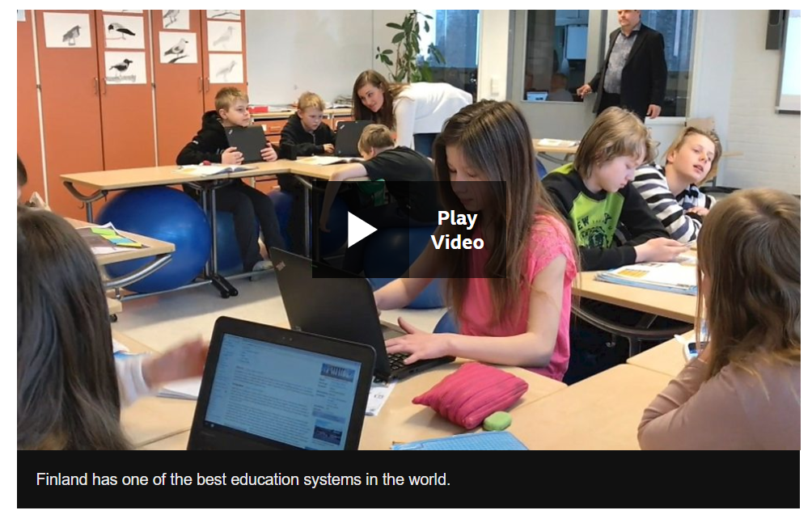
“Finland has long been renowned for the quality of its education and always scores highly in international league tables.
Now it is rethinking how it teaches in the digital age - seeking to place skills, as much as subjects, at the heart of what it does.”
https://www.bbc.com/news/world-europe-39889523

Slide 28
Arguments for critical thinking in the foreign language classroom, regardless of student level:
2. Critical thinking-centered learning will spur on motivation to make meaning in the L2 by engaging students in new ways
Vicious cycle
I only need to repeat, not make meaning.
I don’t express anything interesting.
Learning foreign languages is boring!
Virtuous cycle
I need to express an interesting or unique thought.
I don’t have the language to do it but I find a way.
Learning foreign languages is fun!

Slide 29
How can I incorporate more critical thinking into my teaching?

Slide 30
General rules of thumb
Ask yourself: in completing the assignment….
Can students find the exact answer on the internet? (NO)
Can students copy the answer from each other/submit identical answers? (NO)
Are students: interpreting, analyzing, evaluating, explaining, sequencing, reasoning, comparing, questioning, inferring, hypothesizing, appraising, testing or generalizing? (YES) (https://www.australiancurriculum.edu.au/f-10-curriculum/general-capabilities/critical-and-creative-thinking/)

Slide 31
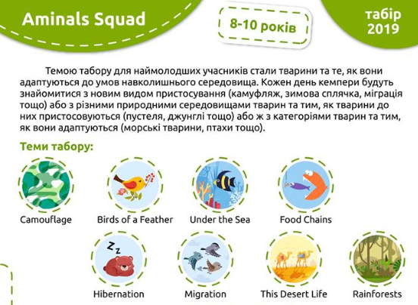
Animals Squad

Slide 32
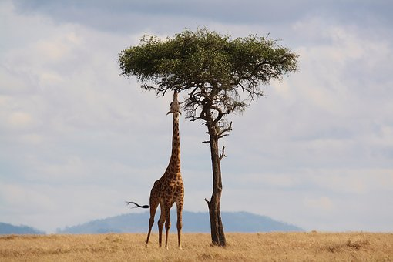
Camp theme: animals and their adaptations
Provides context for diverse activities
Framework for critical thinking

Slide 33
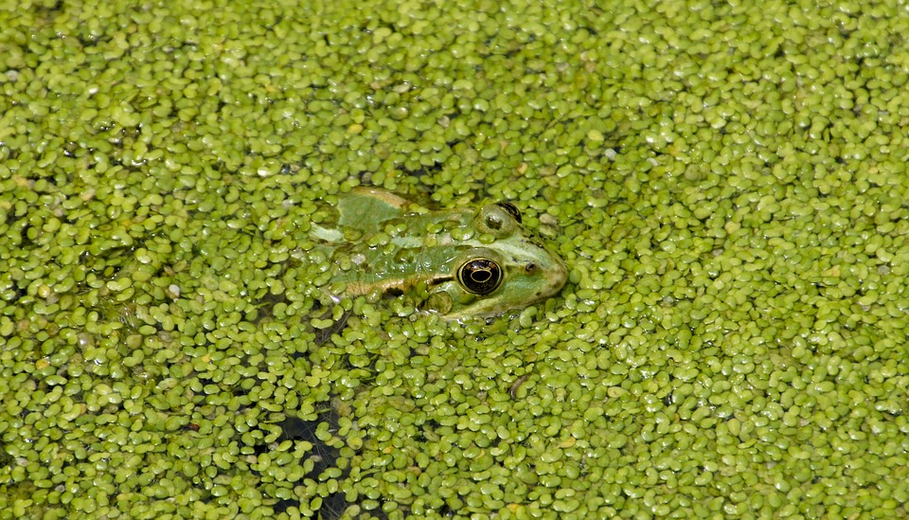
Camp theme: animals and their adaptations
Day 1: Introduction
Day 2: Camouflage
Day 3: Birds of a Feather
Day 4: Under the Sea
Day 5: Food Chains

Slide 34
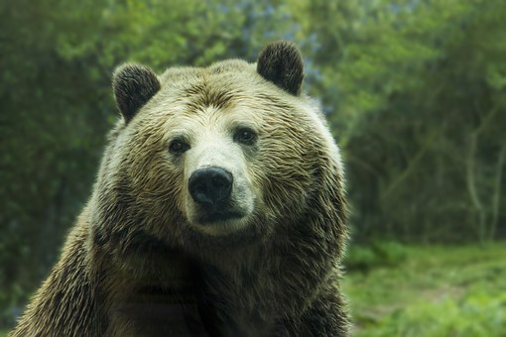
Camp theme: animals and their adaptations
Day 6: Hibernation
Day 7: Migration
Day 8: This Desert Life
Day 9: Rainforests
Day 10: Final Day

Slide 35
Critical thinking activities
interpreting, analyzing, evaluating, explaining, sequencing, reasoning, comparing, questioning, inferring, hypothesizing, appraising, testing or generalizing

Slide 36
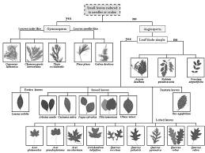
Critical thinking activity: dichotomous key

Slide 37
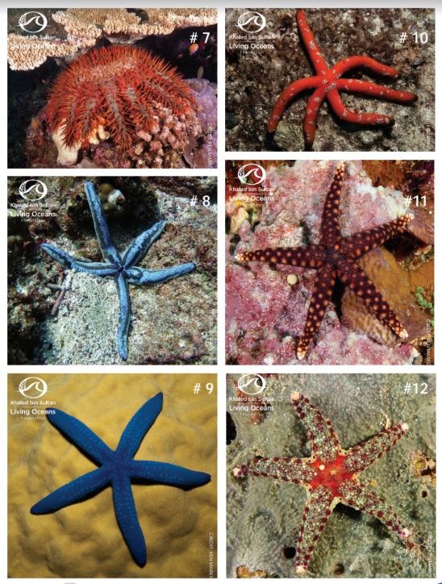
Critical thinking activity: dichotomous key

Slide 38
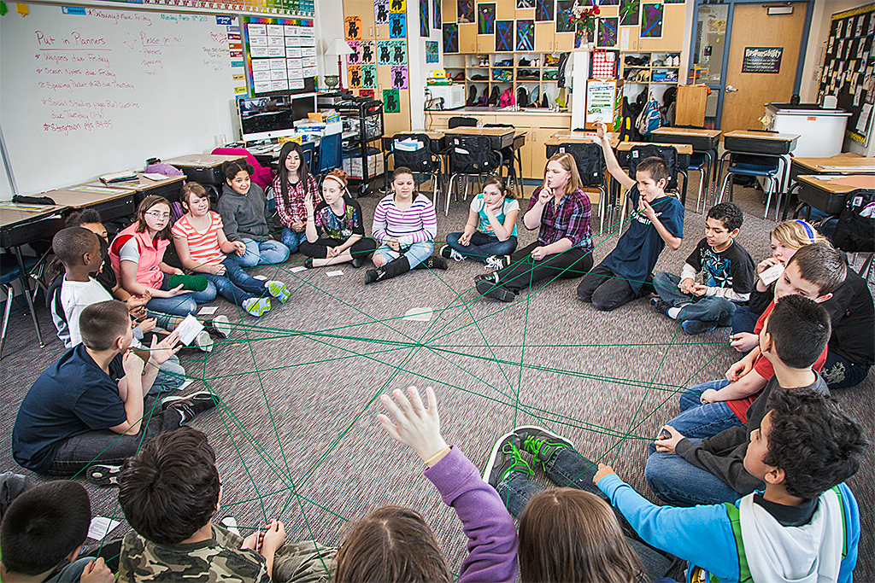
Critical thinking activity: an interactive food web

Slide 39
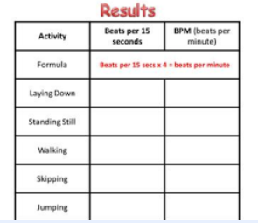
Critical thinking activity: heart rate changes

Slide 40
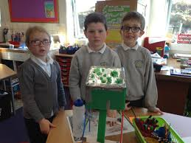
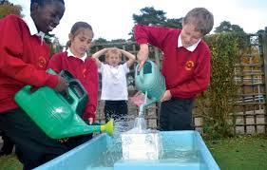
Final day: beat the flood

Slide 41
Part 2: assessment

Slide 42
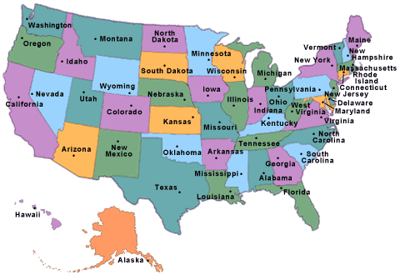
US education system overview
Federal role
State role
Local role

Slide 43
US overview continued
Pre-K
K-12
Higher education
Associate’s degree
Bachelor’s degree
Master’s degree
PhD
Professional degree (MD, JD)

Slide 44
US education: public vs. private
All: 132,853 K-12 schools
Elementary schools: 88,665
Secondary schools: 26,986
Combined schools: 16,511
Other: 691
Traditional public schools: 91,422 (2015-16, Source)
Public charter schools: 6,855 (2015-16, Source)
Private schools: 34,576 (2015-16, Source)
https://www.edweek.org/ew/issues/education-statistics/index.html

Slide 45
Hot topics in US education

Slide 46
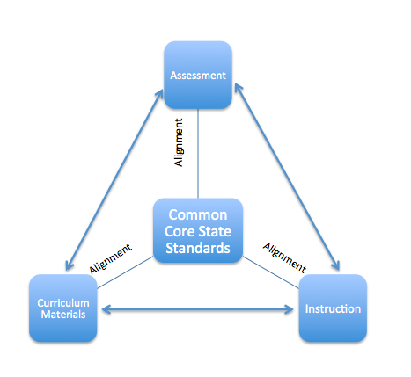
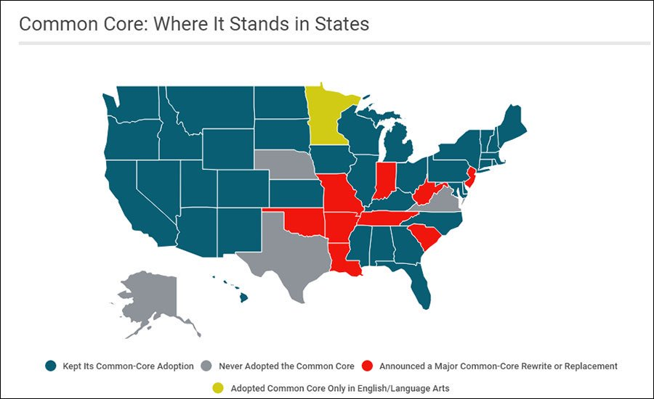
Common Core
https://www.edweek.org/ew/section/multimedia/map-states-academic-standards-common-core-or.html
https://edwp.educ.msu.edu/green-and-write/2015/common-core-state-standards-alignments/

Slide 47
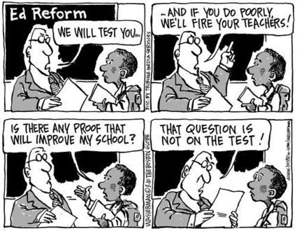
Testing
https://www.scoop.it/topic/standardized-testing-by-meleny-weber

Slide 48
US: English language learners
“The number of English language learners in American public schools continues to rise.
About 9.5 percent of public school students were English language learners in 2015, the U.S. Department of Education reports. That was about 4.8 million students across the country.
That number had risen from 8.1 percent – or 3.8 million students – in 2000, the department’s National Center for Education Statistics said.”
https://learningenglish.voanews.com/a/number-of-english-learners-in-us-schools-keeps-rising/4635659.html

Slide 49
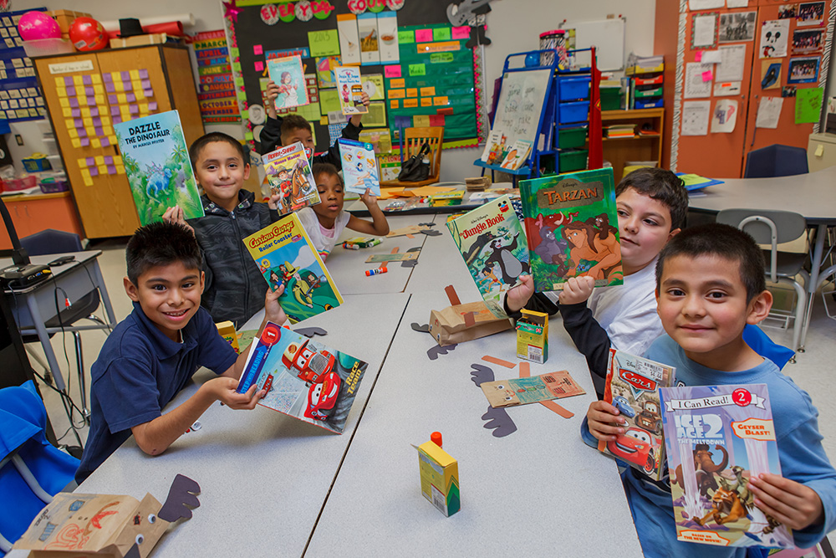
Who are ELLs?
Immigrants and children of immigrants
Heritage language speakers
Speakers of indigenous languages
http://go-neighborhoods.org/northside/esl-classes-at-clemente-martinez-elementary-school/

Slide 50
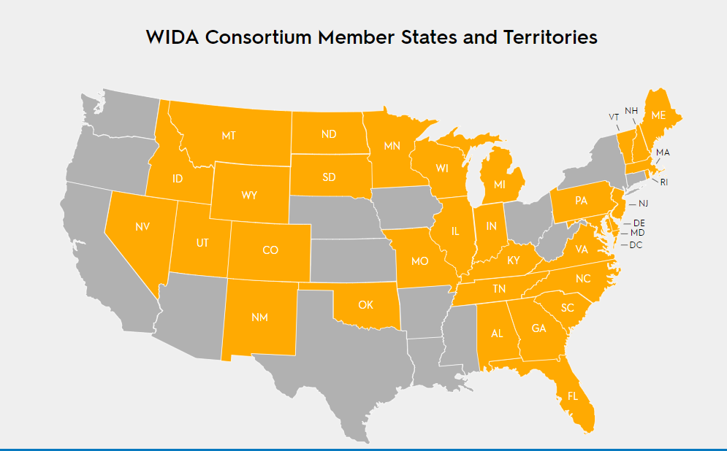
https://wida.wisc.edu/memberships/consortium

Slide 51
https://reports.collegeboard.org/sat-suite-program-results/class-2018-results

Slide 52
https://reports.collegeboard.org/sat-suite-program-results/class-2018-results

Slide 53
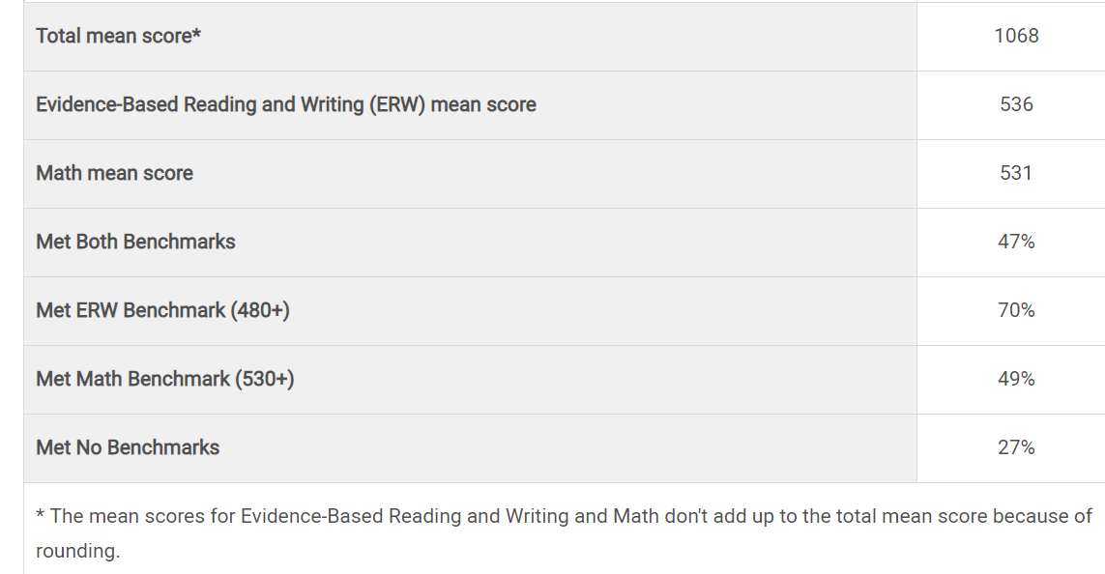
https://reports.collegeboard.org/sat-suite-program-results/class-2018-results

Slide 54
Sat: sources of controversy
Disparate performance across groups
Weight given to scores in college admissions process

Slide 55
Thank you! Дякую! Kristine.nugent@gmail.com

